Slide 1
Hiking trails & Weather App
Shweta Korulkar
Harsha Ramayanam

Slide 2
App Details
Weather and hike trails web application
Check weather, check for hikes. All information can be navigable.
Find a map route to hike trail.

Slide 3
App Features
Home page with links
Link to weather page, link to hike trails page
Links to jump from one page to other page
Search box to search weather of particular place(s)
Search box to search for hike trails
Etc.

Slide 4
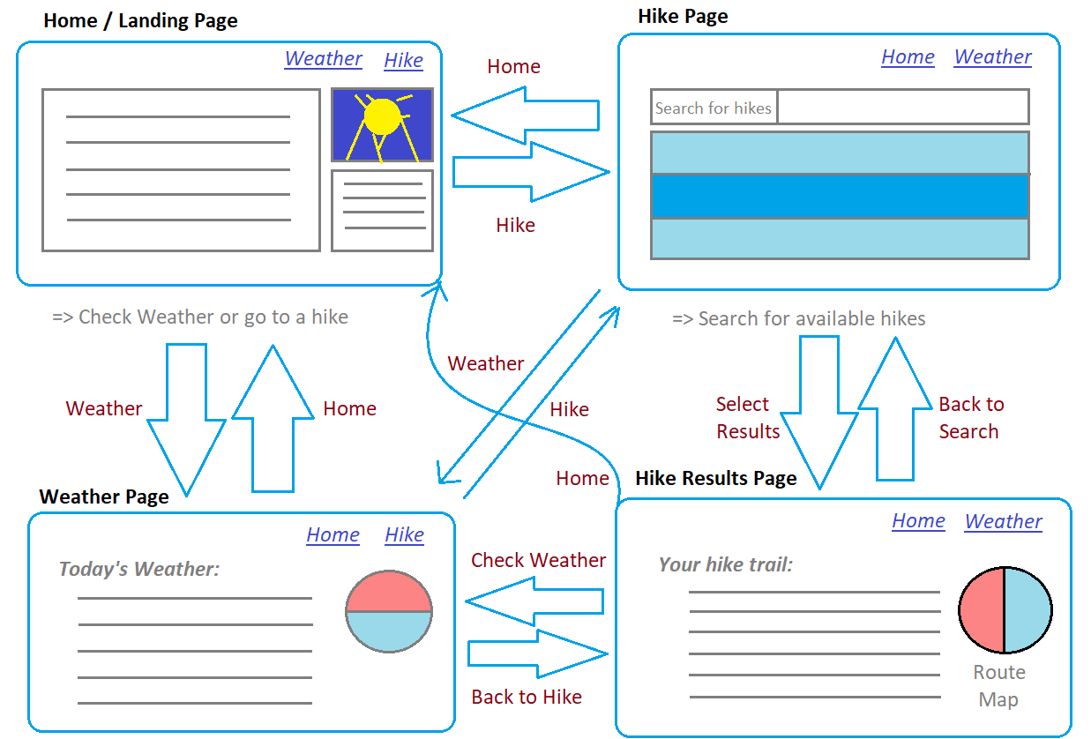
Web Flow

Slide 5
Frameworks/Libraries
React Framework
FetchAPI library and possibly other API libraries,
Stack:
FRONT END → HTML5, CSS3, JAVASCRIPT, ReactJS
BACK END → ExpressJS, Node.js, REST API’s

Slide 6
API’s
Our choices of API’s
Weather APIs
Hike Trail APIs
Map APIs

Slide 7
WEATHER API’s
Weather API:
1) WeatherAPI.com
Limit: 1000000 / month quotaHard Limit
Data Format: FetchAPI
Type: Free public API accessible via authentication key
Information : Access to Search API, Sports API, Last 7 Days History, Hourly Weather, 3 Day Forecast, Realtime Weather, Astronomy API,Time Zone API features.
Popularity: 9.8/10, Latency: 101ms, Service Level: 100%

Slide 8
WEATHER API’s
Weather API:
2) ClimaCell
Limit: 100 / day quota Hard Limit
Data Format: FetchAPI
Type: Free public API accessible via authentication key
Information : Access to Short Term Forecast (Nowcast), Hourly Forecast and Realtime features.
Popularity: 9.6/10, Latency: 493ms, Service Level: 100%

Slide 9
WEATHER API’s
Weather API:
3) OpenWeatherMap
Limit: 500 / month quota Hard Limit
Data Format: FetchAPI
Type: Free public API accessible via authentication key
Information : Access to search Weather API, Historical Weather Data (5 Days), 5 days/3 hour forecast API, Current Weather API features.
Popularity: 9.9/10, Latency: 100ms, Service Level: 98%

Slide 10
HIKE TRAIL API’s
Hike trail API:
1) TrailAPI
Data Format: FetchAPI
Type: Free public API accessible via authentication key
Information : Information and photos for tens of thousands of outdoor recreation locations including hiking and mountain biking trails, campgrounds, ski resorts, ATV trails, and more.
Popularity: 9.3/10, Latency: 840ms , Service Level: 100%

Slide 11
HIKE TRAIL API’s
Hike trail API:
2) Hiking Trails (from data.ny.gov)
Access Data: https://gisservices.dec.ny.gov/gis/dil/
Type: Free public access dataset
Information : This data shows the location of transportation corridors on Department of Environmental Conservation state lands that are approved for foot travel.

Slide 12
MAP API’s
Map API:
1) MapTiles API
Data Format: FetchAPI
Type: Free public API accessible via authentication key
Information : Use our Map Tiles with English, French or Spanish labels based on OpenStreetMap data for your online map or your app map or your desktop software application like QGIS et al.
Popularity: 9.6/10, Latency: 171ms, Service Level: 100%

Slide 13
MAP API’s
Map API:
2) Google Maps Geocoding API
Data Format: FetchAPI
Type: Free public API accessible via authentication key
Information : Geocoding is the process of converting addresses (like "1600 Amphitheatre Parkway, Mountain View, CA") into geographic coordinates (like latitude 37.423021 and longitude -122.083739), which you can use to place markers on a map, or position the map.
Popularity: 9.5/10, Latency: 132ms, Service Level: 100%

Slide 14
MAP API’s
Map API:
3) WeatherAPI.com
Limit: 1000000 / month quotaHard Limit
Data Format: FetchAPI
Type: Free public API accessible via authentication key
Information : WeatherAPI.com is a powerful fully managed free weather and geolocation API provider that provides extensive APIs that range from the weather forecast, historical weather, IP lookup, and astronomy through to sports, time zone, and geolocation.
Popularity: 9.8/10, Latency: 106ms, Service Level: 100%

